Slide 1

Coding Workshop Debugging
06.04.2026
Melissa Franke

Slide 2
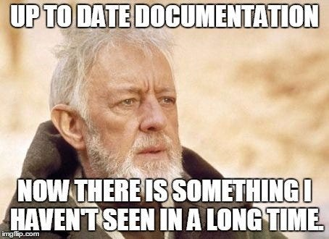

Recap - Documentation
Documentation is useful to understand foreign code without reading the sourcecode
What you need to understand potential packages can also be called API
Not always complete, up to date, helpful
Navigating documentations is a skill, learning it a struggle
Trial and error helps
Coding Workshop
Debugging
Melissa Franke
M.Sc
1

Slide 3
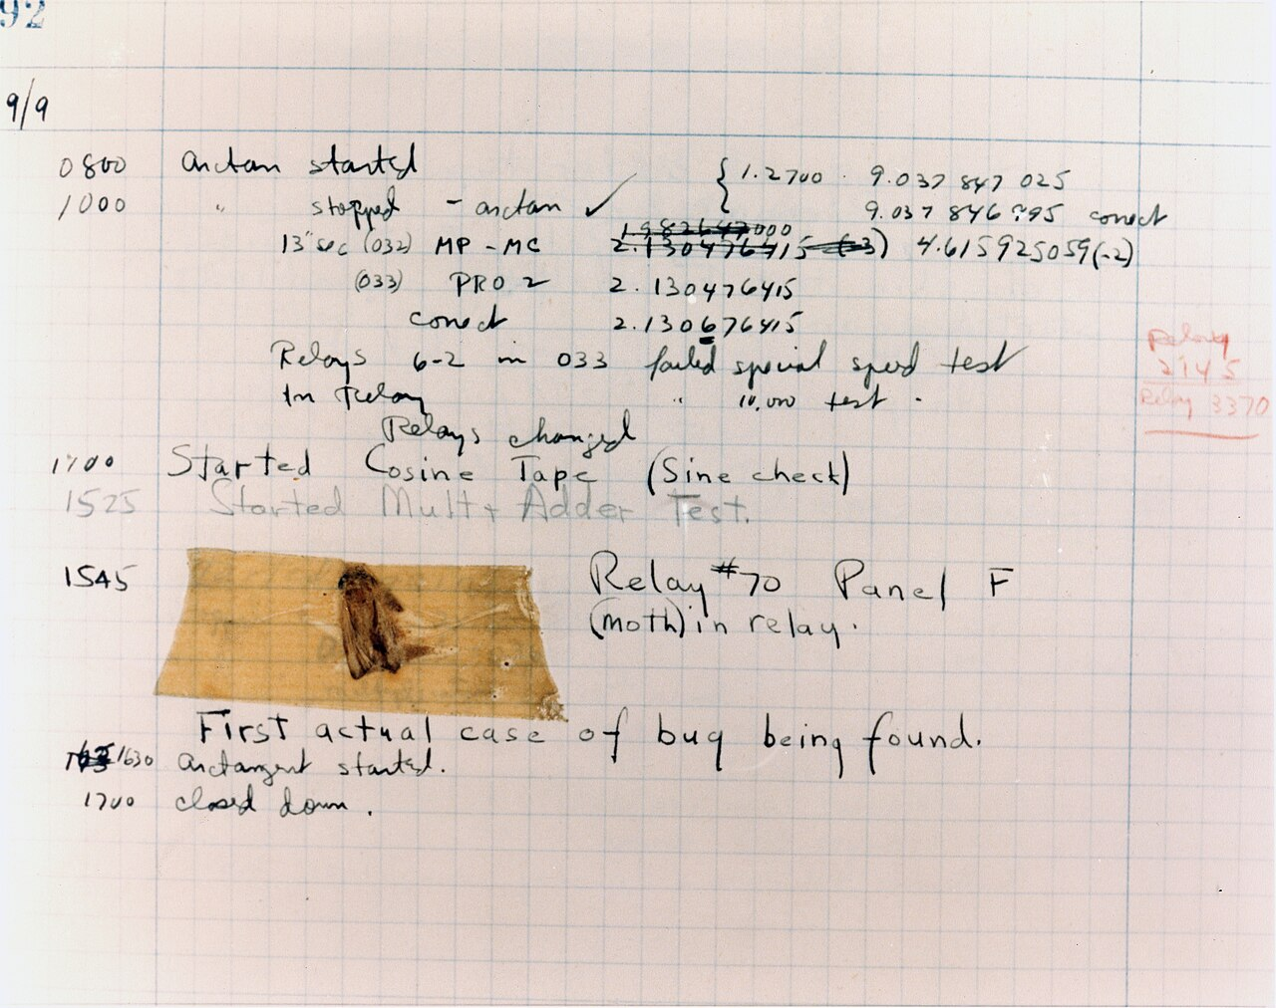
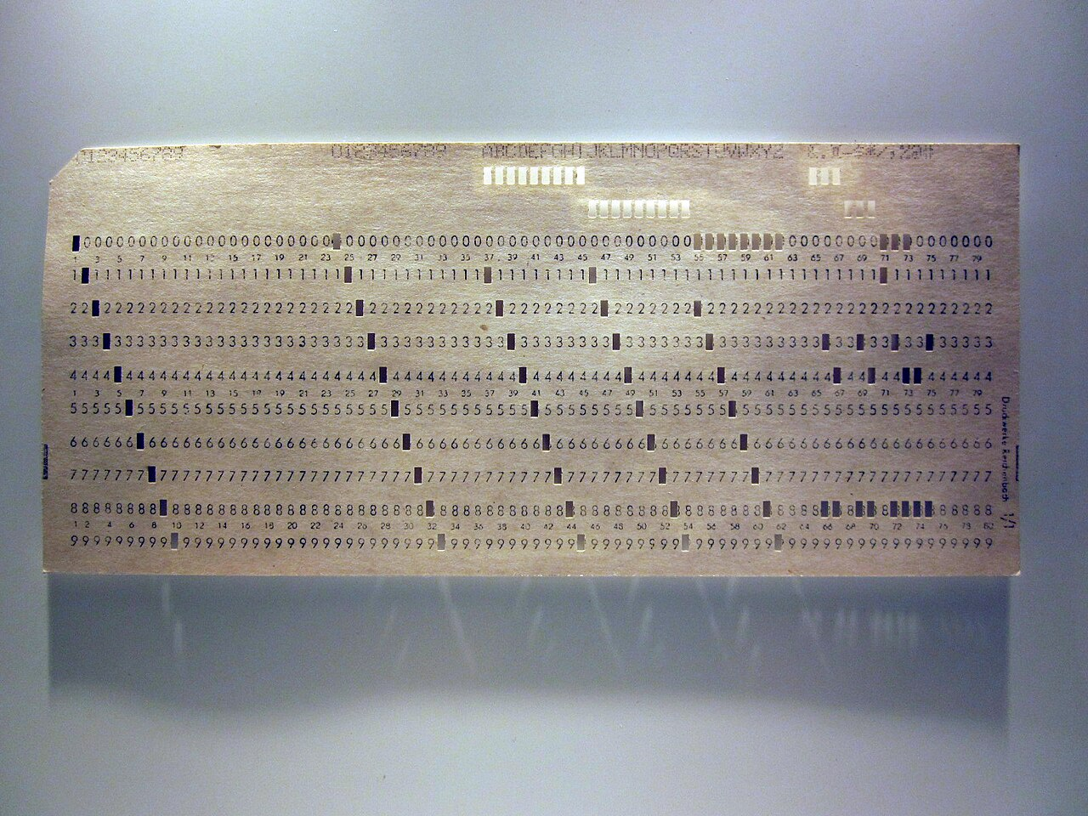
Bugs
Informal term for all errors or un-intended workings of software
Coding Workshop
Debugging
Melissa Franke
M.Sc
2

Slide 4
Types of Bugs
Ranges of severity (data loss, financial loss, frustration, time loss, …)
Categorised by Effects:
Crashing
Freezing
Glitching
Categorised by severity (impact)
Fatal crash – unexpected error, program cannot run, data lost
Controlled crash – expected error, program cannot run, data lost or saved
Operation error – program runs, but calculates the wrong thing
Logic error – the program runs in unexpected ways
…
Coding Workshop
Debugging
Melissa Franke
M.Sc
3

Slide 5
Debugging
Bugs are 99% of the time a 50cm problem
Bugs can be a problem of the OS, the programming language or packages used
Writing bug-free code is the ideal
Writing bug-free, highly complex code is almost impossible
All code needs intensive testing and debugging
Coding Workshop
Debugging
Melissa Franke
M.Sc
4

Slide 6
Common types of Debugging
Preventive debugging
Intensive testing of functions before integrating them into code
Idiot-proof as much as possible: unexpected inputs
Print debugging /tracing
After every major step, set a status-print
Activity tracing
Keep track of hardware resources
Interactive debugging
Start, stop debugger, go line by line, …
Post-mortem debugging
Track files, create logs during runtime to access after crash
Rubber-duck debugging
Your code does not do what you want it to?
Explain it to the rubber duck.
Coding Workshop
Debugging
Melissa Franke
M.Sc
5

Slide 7
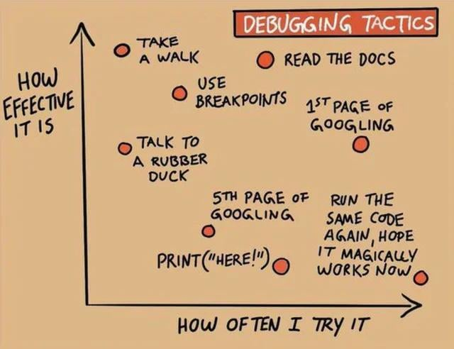
Common types of Debugging
Coding Workshop
Debugging
Melissa Franke
M.Sc
5

Slide 8
Questions?

Slide 9
DO NOT RUN THE EXERCISE CODE
(unless asked to)

Slide 10
Debugging - Exercises
Exercise 1: preventive debugging
Open the file for Exercise 1.
Understand the working code of this exercise.
What does it do?
Run the code with inputs that will get it to crash! The more the better!
How could you idiot-proof the function?
Coding Workshop
Debugging
Melissa Franke
M.Sc
6

Slide 11
Debugging - Exercises
Hints:
You can also keep track of your variables this way!
If you know a calculation is wrong, but there is no obvious error, print the variable at each point it is changed and check in which step a calculation is wrong.
Since the rise of IDEs with integrated debugging, this type of debugging is seldomly used, but still sometimes faster.
Exercise 2: print debugging
Open the file for Exercise 2.
Understand the working code of this exercise.
Ignore the hopefully obvious errors.
Identify the major parts of the functions.
Write print messages after each part similar to:
Print(‘[Step1] started’)
Print(‘[Step1] finished’)
Run the code. What was the last printed message?
Identify the error and correct it.
Coding Workshop
Debugging
Melissa Franke
M.Sc
7

Slide 12
Debugging - Exercises
Exercise 3: activity tracing
RUN THIS AT YOUR OWN RISK – this is a RAM-gobbler
Open the file for Exercise 3.
Understand the code of this exercise.
Ignore the hopefully obvious error.
Open the task manager , run the program and observe the resources accumulated over time. Close the program before your RAM is used up.
At a certain point it should be obvious that the code should not behave this way and that there is an error. (Also the long runtime and the interrupt from the IDE.)
Coding Workshop
Debugging
Melissa Franke
M.Sc
8

Slide 13
Debugging - Exercises
Hints:
You will likely look stupid actually explaining it to a rubber duck.
But it works also if you do it silently in your head.
Exercise 4: rubber duck debugging
Open the file for Exercise 4.
Understand the code of this exercise.
Explain the code line by line.
Find the error.
Coding Workshop
Debugging
Melissa Franke
M.Sc
9

Slide 14
Debugging - Exercises
Hints:
To set a breakpoint, left-click left of the line number.
To delete a breakpoint, click it again.
Continue (F5) runs to the end or next breakpoint
Step over (F10) does not enter functions
Step into (F11) enters functions
Restart (ctrl+shift+F5)
Stop (shift+F5)
Exercise 5: interactive debugging
Open the file for Exercise 5.
This is the same code from Exercise 3.
Set a breakpoint in line 32.
Go through the code line by line.
Once an error was found, set a breakpoint above and correct the error.
Continue until the script is bug-free
Coding Workshop
Debugging
Melissa Franke
M.Sc
10

